Slide 1
Topic 8
Graph and Circuit
資料結構與程式設計
Data Structure and Programming
11/21/2018

Slide 2
From CS to EE? What does that mean?
Most people think that “Data Structure” is a CS class
  A “must” subject for CS entrance exam
In EE area, many problems can be either mapped as graphic problems, or resolved by graphic algorithms
  e.g. Circuit netlist, network, communication, etc.
  Understanding graphic data structure and algorithms will be very helpful

Slide 3
The First Use of Graph
Köigsberg Bridge Problem
  Leonhard Euler, 1736
  Starting at one land, is it possible to walk across all bridges exactly once and returning to the starting land area?
C
C
g
c
d
g
c
d
e
e
A
D
A
D
a
b
f
a
b
f
B
B

Slide 4
Eulerian Theorem
There is a walk starting at any vertex, going through each edge exactly once and terminating at the starting vertex, iff the degree of each vertex is even.
  ➔ Eulerian walk
C
g
c
d
e
No Eulerian walk, since all 4 vertices are of odd degree.
A
D
a
b
f
B

Slide 5
Definition of a Graph
A graph, G(V, E)
  V: a finite, nonempty set of vertices → V(G)
  E: a set of pairs of vertices
  these pairs are called edges → E(G)
Undirected Graph
  Every pair of vertices representing any edge is unordered
  i.e. (u, v) and (v, u) represent the same edge
Directed Graph (Digraph)
  Order of the pair of vertices matters
  <u, v>: ‘u’ is the tail and ‘v’ is the head
  e.g. A circuit is a directed graph
u
v
u
v

Slide 6
Terminologies
Given 2 nodes u, v, and an undirected edge (u, v)
  u and v are called adjacent
  The edge (u, v) is incident on vertices u and v
➔ If <u, v> is a directed edge
  u is adjacent to v, and v is adjacent from u
Degree of a vertex
  The number of edges incident to it
➔ If the graph is directed
  In-degree
    The number of edges for which the vertex is the head
  Out-degree
    The number of edges for which the vertex is the tail
v
u

Slide 7
Terminologies
Path
  A sequence of vertices in which each vertex is adjacent to the next one
    e.g. { n₁, e₁, n₂, e₂, n₃, e₃, ..., e_{k-1}, n_{k} }
Simple path
  All vertices in a path are distinct
Length of a path
  The number of edges in a path
Loop (self-edge)
  An edge with 2 identical end-points
Cycle
  A path with identical start and end points

Slide 8
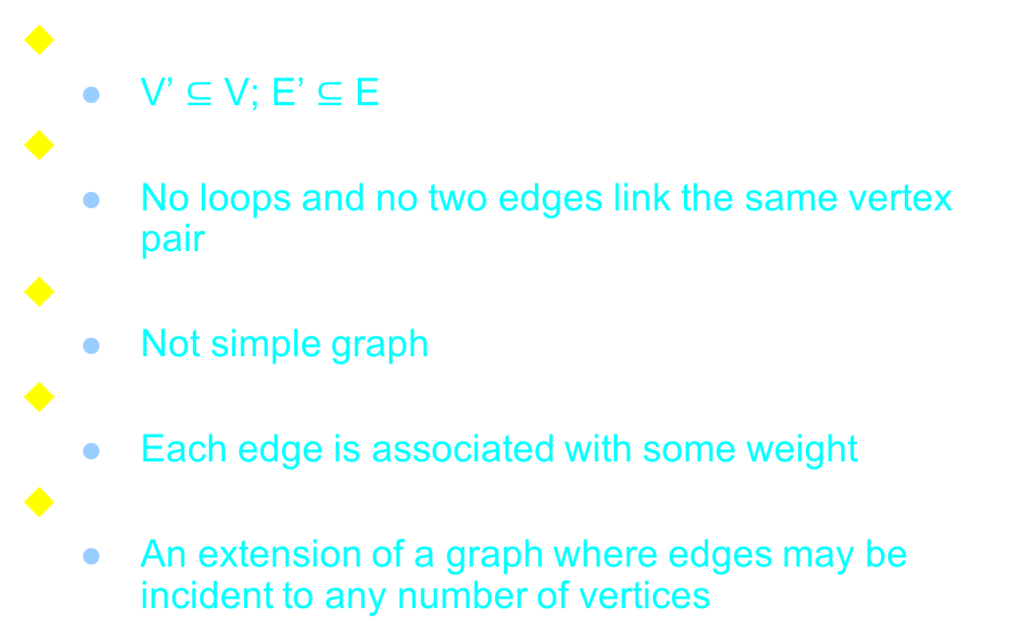
Graph Properties
Subgraph G(V’, E’) of G(V, E)
  V’ $⊆$ V; E’ $⊆$ E
Simple graph
  No loops and no two edges link the same vertex pair
Multigraph
  Not simple graph
Weighted graph
  Each edge is associated with some weight
Hypergraph
  An extension of a graph where edges may be incident to any number of vertices

Slide 9
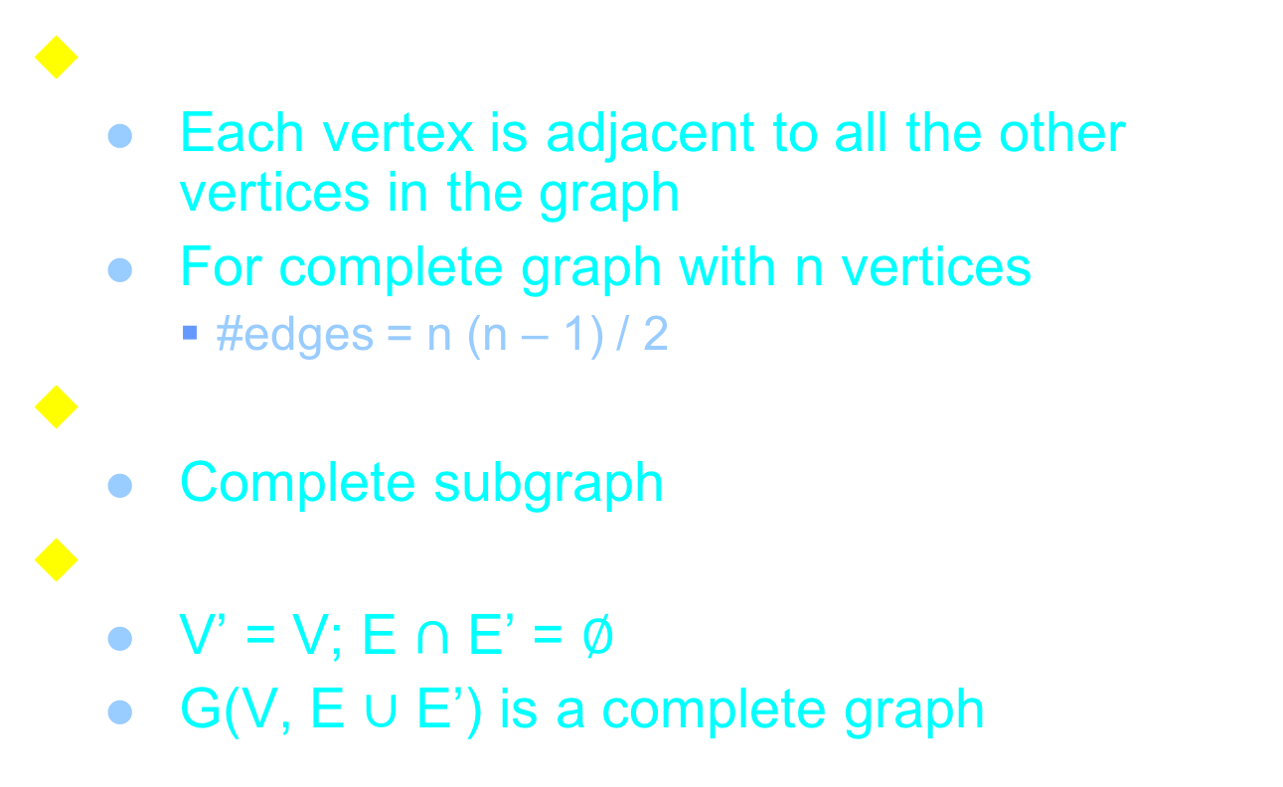
Complete Graph
Complete graph
  Each vertex is adjacent to all the other vertices in the graph
  For complete graph with n vertices
    #edges = n (n – 1) / 2
Clique of a graph
  Complete subgraph
Complement G(V’, E’) of a graph G(V, E)
  V’ = V; E $∩$ E’ = $∅$
  G(V, E $∪$ E’) is a complete graph

Slide 10
Undirected Graph Properties
Two vertices u and v are said to be connected
  iff there a path from u to v
A graph is said to be connected
  iff every vertex pair is connected
  ➔ A tree is a connected acyclic graph
A connected component (or simply component) of a graph
  A maximal connected subgraph

Slide 11
(FYI) Maximal vs. Maximum
Maximal
Maximum
minimum
minimal
In many problems, finding maximum/minimum is very hard
  Finding maximal/minimal is the only possibility
How to find a better maximal/minimal?

Slide 12
Undirected Graph Properties
Cutset
  A minimal set of edges whose removal from the graph makes the graph disconnected
Bipartite graph
  Vertex set can be partitioned into 2 subsets such that each edge has end-points in different subsets
u
t
w
v

Slide 13
Undirected Graph Properties
Plannar graph
  A diagram on a plane surface such that no two edges cross
Two graphs are isomorphic
  There is a one-to-one correspondence between their vertex sets and preserves adjacency

Slide 14
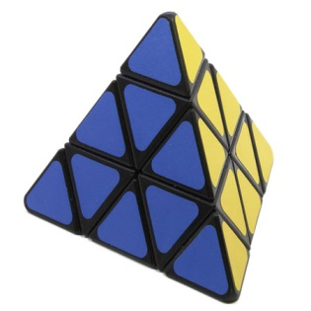
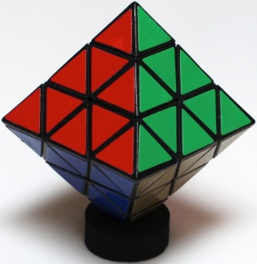
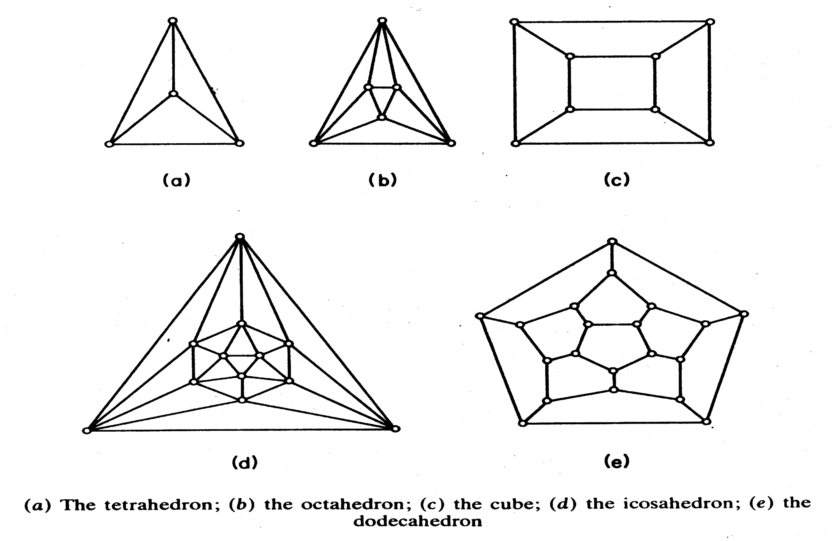
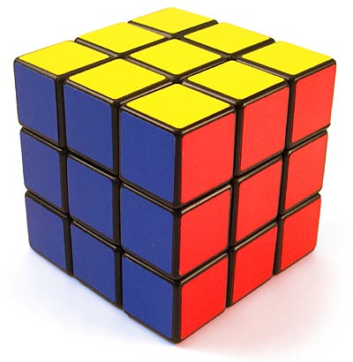

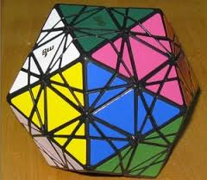
Some interesting plannar graphs

Slide 15
Undirected Graph Properties
Each undirected graph can be characterized by four numbers
Clique number ω(G)
  The cardinality of its largest clique, called clique number
Chromatic number χ(G)
  The minimum number of colors needed to color the vertices, such that no edge has end-points with the same color
  e.g. A bipartite graph is a 2-colorable graph
Property: ω(G) ≦ χ(G)
Notes:
X ➔ kai

Slide 16
Undirected Graph Properties
Clique cover number κ(G)
  A graph is said to be partitioned into cliques if its vertex set is partitioned into (disjoint) subsets, each one including a clique
  The cardinality of a minimum clique partition is called Clique cover number
Stability number α(G)
  A stable set, or independent set, is a subset of vertices with the property that no two vertices in the stable set are adjacent
  The stability number is the cardinality of its largest stable set
  A coloring of a graph is a partition of the vertices into subsets, such that each is a stable set
Property: α(G) ≦ κ(G)
Notes:
k ➔ kappa

Slide 17
Perfect Graph
A graph is said to be perfect iff
  ω(G) = χ(G) (clique = chromatic)
  α(G) = κ(G) (stability = clique covering)
ω(G) = χ(G) = 3
α(G) = κ(G) = 2

Slide 18
Any graph that is NOT perfect?
That is:
Clique number ω(G) < Chromatic number χ(G)
Stability number α(G) < Clique cover number κ(G)
Notes:
其實五邊形就可以了!!

Slide 19
Directed Graph Properties
A digraph is said to be strongly connected
  Iff for every pair of distinct vertices u and v, there is a path from u to v, also from v to u
Strongly connected component (SCC)
  Maximal subgraph that is strongly connected
  If a graph is strongly connected, it has only one SCC
  Linear time algorithm for finding SCCs:
  Robert E. Tarjan, Depth-first search and linear graph algorithms, SIAM Journal on Computing, 1(2):146-160, 1972.

Slide 20
Directed Acyclic graph (DAG)
A directed graph that has no cycle
Can represent partially ordered set
  A vertex v is a successor (descendant) of a vertex u
    If there is a path from u to v
    Called direct successor if the path is an edge
  Predecessor (ancestor)
Polar DAG
  A DAG with 2 distinguished vertices
    A source and a sink
  All vertices are reachable from the source
  Sink is reachable from all the vertices
  A generic polar DAG may have multiple sources and sinks

Slide 21
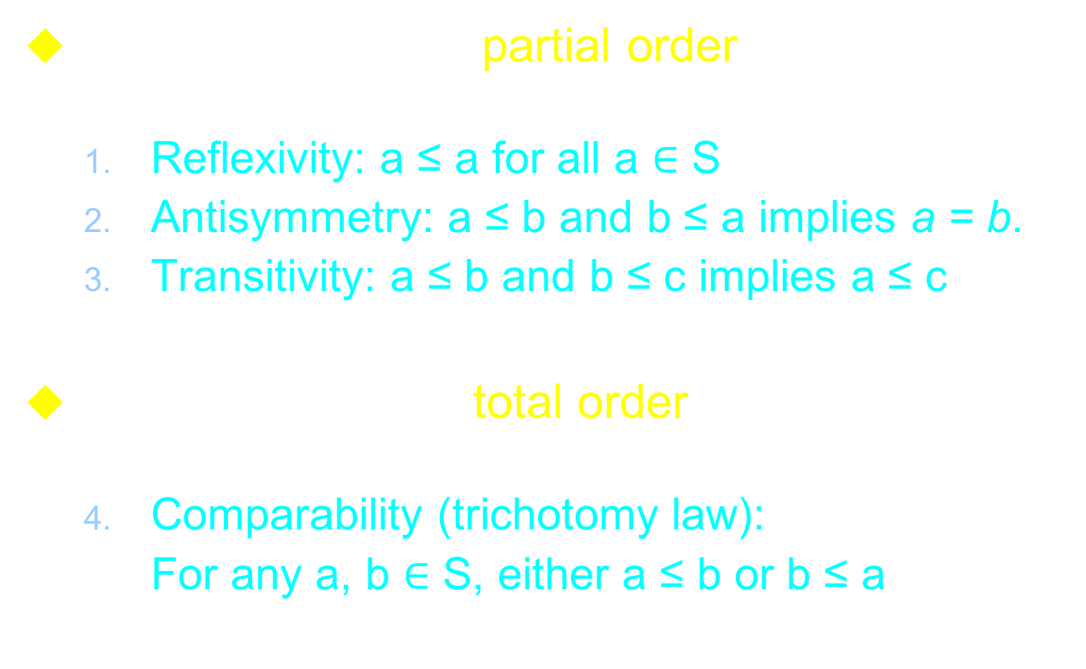
Partially vs. Totally Ordered Set
A relation “$≼$” is a partial order on a set S if it has:
  Reflexivity: a ≤ a for all a $∈$ S
  Antisymmetry: a ≤ b and b ≤ a implies a = b.
  Transitivity: a ≤ b and b ≤ c implies a ≤ c
A relation “≤” is a total order on a set S if it has the above 3 properties and the following:
  Comparability (trichotomy law):
  For any a, b $∈$ S, either a ≤ b or b ≤ a

Slide 22
A Partial Order Example
The “containment” relation among the subsets of a set is a partial order
{ a, b, c, f, g }
{ a, b, f }
{ b, c, g }
{ a }
{ b }
{ c, g }

Slide 23
Graphic Algorithms
The importance of learning “graphs” is that many practical problems can be modeled and then solved by standard/well-known graphic algorithms
  Breadth-First Search and Depth-First Search
  Topological Sort
  Strongly Connected Component
  Shortest and Longest Path Algorithms
  Minimum Spanning Tree
  Maximum Flow and Minimum Cut
Please refer to “Algorithm” book or class for more information
  We may cover some of them if we have time...

Slide 24
Graph Traversal
In many graph (DAG) applications, it is important to go through every vertex in certain order
  e.g. checkSum(), simulate(), etc
Topological order
  An order sorted by certain relationship of adjacent vertices
  e.g.
    For each vertex, it has higher order than all of its predecessors, and lower order than all of its successors

Slide 25
Depth-First Traversal (Take 1)
void
Graph::dfsTraversal(const List<Node*>& sinkList)
{
for_each_sink(node, sinkList)
node->dfsTraversal(_dfsList);
}
// post order traversal
void Node::dfsTraversal(List<Node *>& dfsList)
{
for_each_predecessor(next, _predecessors)
next->dfsTraversal(dfsList);
dfsList.push_back(this);
}
Any Problem??

Slide 26
Depth-First Traversal (Take 2)
void
Graph::dfsTraversal(const List<Node*>& sinkList)
{
for_each_sink(node, sinkList)
node->dfsTraversal(_dfsList);
}
// post order traversal
void Node::dfsTraversal(List<Node *>& dfsList)
{
for_each_predecessor(next, _predecessors)
if (!next->isMarked()) {
next->setMarked();
next->dfsTraversal(dfsList);
}
dfsList.push_back(this);
}
Any Problem??

Slide 27
Depth-First Traversal (Take 3)
void
Graph::dfsTraversal(const List<Node*>& sinkList)
{
for_each_sink(node, sinkList)
node->dfsTraversal(_dfsList);
for_each_node(node, _dfsList)
node->unsetMarked();
}
// post order traversal
void Node::dfsTraversal(List<Node *>& dfsList)
{
for_each_predecessor(next, _predecessors)
if (!next->isMarked()) {
next->setMarked();
next->dfsTraversal(dfsList);
}
dfsList.push_back(this);
}
Any Problem??

Slide 28
Depth-First Traversal (Take 4)
Remember: use “static data member in a class”
class T
{
static unsigned _globalRef;
unsigned _ref;
public:
T() : _ref(0) {}
bool isGlobalRef(){ return (_ref == _GlobalRef); }
void setToGlobalRef(){ _ref = _globalRef; }
static void setGlobalRef() { _globalRef++; }
};
Use this method to replace “setMarked()” functions in graph traversal problems

Slide 29
Depth-First Traversal (Take 4)
void
Graph::dfsTraversal(const List<Node*>& sinkList)
{
Node::setGlobalRef();
for_each_sink(node, sinkList)
node->dfsTraversal(_dfsList);
}
// post order traversal
void Node::dfsTraversal(List<Node *>& dfsList)
{
for_each_predecessor(next, _predecessors)
if (!next->isGlobalRef()) {
next->setToGlobalRef();
next->dfsTraversal(dfsList);
}
dfsList.push_back(this);
}
Any Problem??

Slide 30
Depth-First Traversal (Take 5)
void
Graph::dfsTraversal(const List<Node*>& sinkList)
{
Node::setGlobalRef();
for_each_sink(node, sinkList)
node->dfsTraversal(_dfsList, _fbList);
}
// post order traversal
void Node::dfsTraversal
(List<Node *>& dfsList, list<NodePair>& fbList)
{
for_each_predecessor(next, _predecessors)
if (!next->isGlobalRef()) {
next->setToGlobalRef();
next->setActive();
next->dfsTraversal(dfsList, fbList);
next->unsetActive();
}
else if (next->isActive())
fbList.push_back(NodePair(this, next));
dfsList.push_back(this); // not push_back(next); why?
}

Slide 31
Breath-First Traveral
algorithm levelOrder(TreeNode t)
  Input: a tree node (can be considered to be a tree)
  Output: None.
  Let Q be a Queue
  Q.enqueue(t)
  while the Q is not empty
  tree = Q.dequeue()
  Visit node tree
  if tree has a left child
  Q.enqueue(left child of tree)
  if tree has a right child
  Q.enqueue(right child of tree)
How about the “marked” and “loop” Issues ??

Slide 32
Tarjan's Strongly Connected Components (SCC) algorithm
Global: idx = 0; S = empty; SCCGroup = empty;
for_each_node (v, G)
if (v is unvisited) SCC(v);
Func SCC(v) {
v.idx1 = v.idx2 = idx; idx++; // DFS labeling
S.push(v); v.setVisited();
for_each_predecessor (v, w) { // v → w
if (w is unvisited) {
SCC(w);
v.idx2 = min(v.idx2, w.idx2);
} else if (w is in S) {
v.idx2 = min(v.idx2, w.idx1);
}
}
if (v.idx1 == v.idx2) {
SCCGroup.add(S); S.flush();
}
}

Slide 33
1
3
6
7
2
4
5
8
Global: idx = 0; S = empty; SCCGroup = empty;
for_each_node (v, G)
if (v is unvisited) SCC(v);
Func SCC(v) {
v.idx1 = v.idx2 = idx; idx++; // DFS labeling
S.push(v); v.setVisited();
for_each_predecessor (v, w) { // v → w
if (w is unvisited) {
SCC(w);
v.idx2 = min(v.idx2, w.idx2);
} else if (w is in S) {
v.idx2 = min(v.idx2, w.idx1);
}
}
if (v.idx1 == v.idx2) {
SCCGroup.add(S); S.flush();
}
}

Slide 34
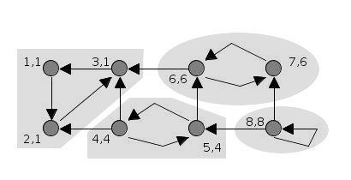
Tarjan's Strongly Connected Components (SCC) algorithm

Slide 35
Graph Implementation (1)
0
1
Adjacency Matrix
  class Graph
  {
  bool _adjacency[n][n];
  };
  For undirected graph → upper triangle
  How to perform traversal?
  Difficult to implement
  various graphic algorithms
  Could be a sparse matrix
  Complexity can be as high as O(n²)
2
3
0 1 2 3
0
1
2
3
0 1 1 1
1 0 0 1
1 0 0 1
1 1 1 0

Slide 36
Graph Implementation (2)
0
2
1
3
Adjacency List
  class Graph
  {
  List<int> *_headNodes;
  int _numNodes;
  };
  Better for sparse matrix
  Require n _headNodes and 2*e ListNodes
  (u, v) and (v, u) redefined
  Some operations may still be as expensive as O(n + e)
1
3
0
.......
0 1 2 3
0
1
2
3
0 1 1 1
1 0 0 1
1 0 0 1
1 1 1 0

Slide 37
Graph Implementation (3)
_vertex1
_vertex2
_path1
_path2
Adjacency Multilist
  class Edge
  {
  bool _visited;
  int _vertex1, vertex2;
  Edge *_path1, *_path2;
  };
  class Graph
  {
  Edge** _headNodes;
  int _numNodes;
  };
  Same memory requirement as “adjacent list”
  (except for _visited field))
  Not very intuitive to understand
N0
0
1
N1
N3
N1
0
2
N2
N3
N2
0
3
0
N4
N3
1
2
N4
N5
N4
1
3
0
N5
N5
2
3
0
0
0
N0
N1
N2
1
N3
2
N4
3
N5

Slide 38
Graph Implementation (4)
Two dynamic arrays
  class Node
  {
  Array<Node *> _successors;
  Array<Node *> _predecessors;
  };
  class Graph
  {
  Array<Node *> _nodes;
  // Array<Node *> _sinks;
  // Array<Node *> _sources;
  };
  Memory usage is about the same (n + 2 * e)
  A more intuitive implementation

Slide 39
Graph Implementation (5)
To contain data in nodes
  template <class T>
  class Node
  {
  T _data;
  Array<Node<T> *> _successors;
  Array<Node<T> *> _predecessors;
  };
  template <class T>
  class Graph
  {
  Array<Node<T> *> _nodes;
  };

Slide 40
Circuit
A directed diagram for representing the current flow of an electronic design
h and g are f’s fanouts
f is h’s and g’s fanin
pin
net
h
f
Primary Inputs (PIs)
g
Primary outputs (POs)
gate
(cell)
gate
(cell)

Slide 41
Circuit Implementation (1)
Cell-based implementation (1)
  class Gate
  {
  GateType _type;
  GateFlag _flag; // visited, etc
  Array<Gate *> _faninList;
  Array<Gate *> _fanoutList;
  };
  class Circuit
  {
  Array<Gate *> _piList;
  Array<Gate *> _poList;
  Array<Gate *> _totalList;
  };
  Gate::_type is to distinguish different functionalities
    Drawback: usually need a BIG switch in codes

Slide 42
Circuit Implementation (2)
Cell-based implementation (2)
  class Gate
  {
  GateType _type;
  GateFlag _flag;
  Array<Gate *> _faninList;
  Array<Gate *> _fanoutList;
  };
  class And : public Gate
  {
  };
  class Circuit
  {
  Array<Gate *> _piList;
  Array<Gate *> _poList;
  Array<Gate *> _totalList;
  };

Slide 43
Virtual Functions for Different Types of Gates
class Gate {
virtual bool simulate() = 0;
};
class And : public Gate {
bool simulate() { ... }
};
===============================
void Circuit::constructNetlist() {
Gate* newGate = new And;
...
}
bool Circuit::simulate() {
for_each_gate(thisGate, _totalList)
thisGate->simulate(); // Will call And::simulate()
...
}

Slide 44
Circuit Implementation (2)
Net-based implementation
  class Net
  {
  Array<Pin *> _inPinList;
  Array<Pin *> _outPinList
  };
  class Pin
  {
  Gate* _gate;
  Net* _net;
  };
  class Gate
  {
  GateFlag _flag;
  Array<Pin *> _inPinList;
  Array<Pin *> _outPintList;
  };
gate
pin
net
pin
gate

Slide 45
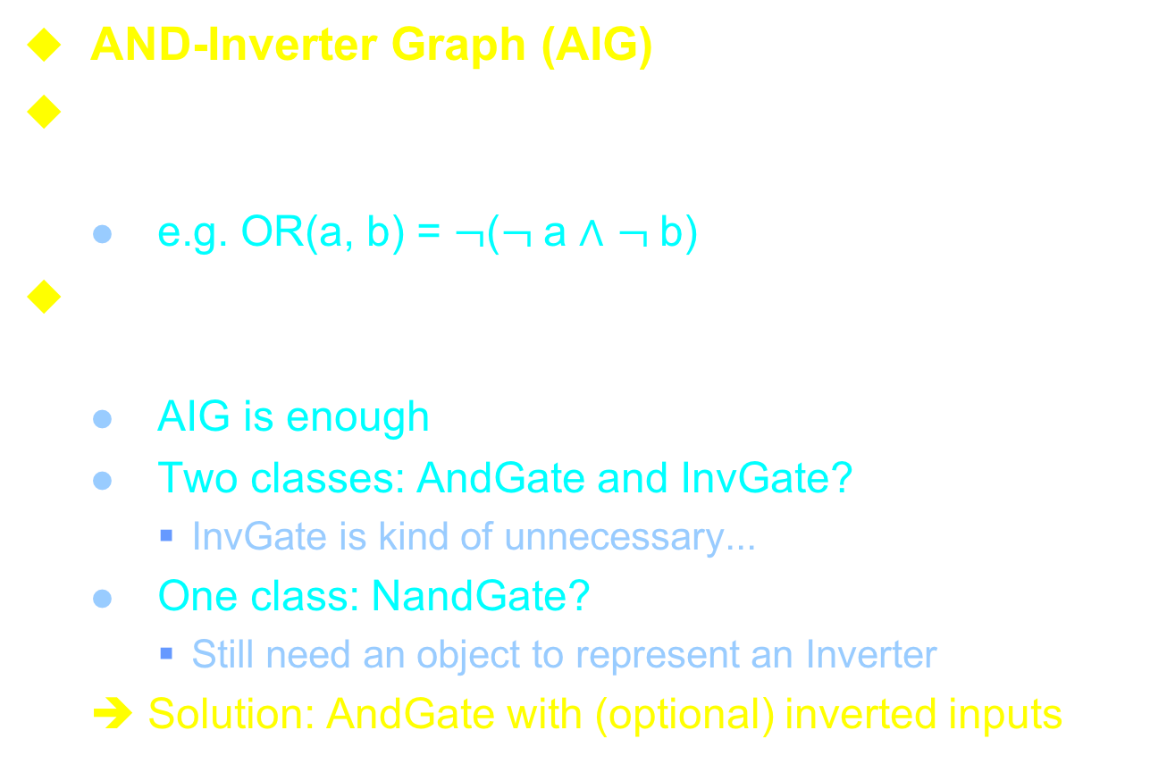
Circuit Implementation (3)
AND-Inverter Graph (AIG)
All the Boolean functions can be represented by “And: $∧$” and “Inverter: $¬$”
  e.g. OR(a, b) = $¬$($¬$a $∧$ $¬$b)
As for circuit implementation, it is better to have simpler data structure
  AIG is enough
  Two classes: AndGate and InvGate?
    InvGate is kind of unnecessary...
  One class: NandGate?
    Still need an object to represent an Inverter
  ➔ Solution: AndGate with (optional) inverted inputs

Slide 46
AIG Implementation
class AigGate {
Array<AigGateV> _faninList;
size_t _ref;
static size_t _globalRef_s
};
class AigGateV {
#define NEG 0x1
AigGateV(AigGate* g, size_t phase):
_gateV(size_t(g) + phase) { }
AigGate* gate() const {
return (AigGate*)(_gateV & ~size_t(NEG)); }
bool isInv() const { return (_gateV & NEG); }
size_t _gateV;
};

Slide 47
AIGER Format
An simplified, well-accepted AIG format
  Documents and source codes available at: http://fmv.jku.at/aiger/
Two versions
  ASCII format: text format ⬅ HW #6
  Binary format: more compact representation
  ➔ In HW#6 and final project, we will handle ASCII format only

Slide 48
AIGER ASCII Format
ASCII format contains several sections
  Header
  Inputs
  Latches // ignored in HW#6
  Outputs
  ANDs
  Symbols
  Comments
Except for header, any of the above sections can be omitted if it is not necessary
  However, their relative order cannot be altered

Slide 49
AIGER ASCII Format
Header
  [Syntax] aag M I L O A
    aag: specify ASCII AIG format
      [cf] aig: specify binary format
    M: maximal variable index
    I, L, O, A: number of inputs, latches, outputs, AND gates
  [Example] aag 7 2 0 2 3
  [Note]
    Exact ONE space before M, I, L, O, A
    “A” must be immediately followed by a “new line” char.
    If all variables are used and there are no unused AND gates, then M = I + L + A.

Slide 50
AIGER ASCII Format
Variables and Literals
  Each input, latch, and AND gate is assigned with a distinct variable ID (i.e. an unsigned number)
    Between [1, M]
    Variable 0 means constant FALSE.
    The input, latch, and AND variable IDs can be arbitrary. No one is necessarily bigger/smaller than the other.
  A “literal” is a positive or negative form of a variable
    Let v be the ID of a variable, than the literal (2v) and (2v+1) stands for the positive and negative forms of the variable, respectively
    e.g. Literal 12 is the positive form of variable 6
    Literal 1 stands for constant TRUE

Slide 51
AIGER ASCII Format
Inputs
  [Syntax] <inputLiteralID>
  [Example] 2
  [Note]
    Each line defines exactly one input, which is represented as a literal ID
    Inputs are non-negative, so the literal IDs must be even numbers
Example
  aag 3 2 0 1 1 // header
  2 // input 0
  4 // input 1

Slide 52
AIGER ASCII Format
Latches
  [Syntax] <currStateLiteralID> <nextStateLiteralID>
  [Example] 8 15
  [Note]
    Each line defines exactly one latch, which contains the current state literal ID followed by the next state ID
    Currnet states are non-negative (as inputs), so their literal IDs must be even numbers
    Next states can be inverted (as outputs), so their literal IDs can be positive or negative

Slide 53
AIGER ASCII Format
Outputs
  [Syntax] <outputLiteralD>
  [Example] 9
  [Note]
    Each line defines exactly one output, which is represented as a literal ID
    Outputs can be inverted, so their literal IDs can be even or odd
Example
  aag 3 2 0 1 1 // header
  2 // input 0
  4 // input 1
  6 // output 0

Slide 54
AIGER ASCII Format
AND gates
  [Syntax] <LHS> <RHS1> <RHS2>
  [Example] 12 7 15
  [Note]
    Each line defines exactly one AND gate, which containts the LHS literal followed by exactly two RHS literals
    LHS literals must be even, and the RHS literals can be even or odd (i.e. non-inverted or inverted)
Example
  aag 3 2 0 1 1 // header
  2 // input #0 (var id = 1)
  4 // input #1 (var id = 2)
  6 // output #0 (var id = 3)
  6 2 4 // AND gate 3 = 1 & 2

Slide 55
AIGER ASCII Format
Symbols
  [Syntax] [ilo]<position> <symbolicName>
  [Example] i0 reset
  o1 done
  [Note]
    Each line defines exactly one symbolic name for inputs, latches, or outputs
    There is at most ONE symbolic name for each input, latch, or output
    <position> denotes the position of the corresponding input/latch/output is defined in it section. It counts from 0.
    Symbolic name can contain any printable character, except for “new line”
      [Note] White space and numbers are allowed in names

Slide 56
AIGER ASCII Format
Comments
  [Syntax] c
  [anything]…
  [Example] c
  Game over!!
  [Note]
    The comment section starts with a c character followed by a new line. The following lines are comments.

Slide 57
Notes on AIGER Format
No leading or trailing spaces in each line
No empty line
“New line” character must present at the end of each line
All parsed tokens in the same line, except for comments, must be separated by exactly ONE space character
Need to identify undefined literals and floating signals in parser

Slide 58
AIGER Examples
Empty circuit
  aag 0 0 0 0 0 // header
And gate
  aag 3 2 0 1 1 // header
  2 // input #0 (var id = 1)
  4 // input #1 (var id = 2)
  6 // output #0 (var id = 3)
  6 2 4 // AND gate 3 = 1 & 2
Or gate
  aag 3 2 0 1 1
  2 // input #0 (var id = 1)
  4 // input #1 (var id = 2)
  7 // output #0 (var id = 3)
  6 3 5 // AND gate 3 = !1 & !2

Slide 59
AIGER Examples
Half Adder
  aag 7 2 0 2 3 // header line
  2 // input #0 1st addend bit 'x'
  4 // input #1 2nd addend bit 'y'
  6 // output #0 sum bit 's'
  12 // output #1 carry 'c'
  6 13 15 // AND gate #0 x ^ y
  12 2 4 // AND gate #1 x & y
  14 3 5 // AND gate #2 !x & !y
  i0 x // symbol
  i1 y // symbol
  o0 s // symbol
  o1 c // symbol
  c // comment header
  half adder // comment

Slide 60
Some notes about HW#6
Topic: An AIGER parser
  Parse an AIGER netlist file into a circuit data structure (a DAG)
    Note: Error handling can be VERY complicated... Try to work on “good” circuits first!!
  Check for floating/undefined variables
  Check for cyclic conditions
  Report circuit statistics
  Report gate connections
  Perform logic simulations
  Output AIG file

